Slide 1
Deep learning vs. Machine learning vs. Artificial Intelligence

Slide 2
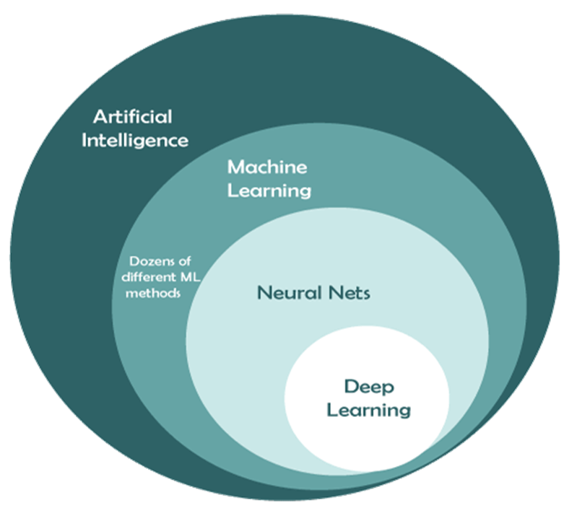

Slide 3
What is Artificial Intelligence (AI)?
Artificial Intelligence is defined as a field of science and engineering that deals with making intelligent machines or computers to perform human-like activities.
Mr. John McCarthy is known as the godfather of this amazing invention. There are some popular definitions of AI, which are as follows:
"AI is defined as the capability of machines to imitate intelligent human behaviour."
"A computer system able to perform tasks that normally require human intelligence, such as visual perception, speech recognition, decision-making, and translation between languages.“
Types of Artificial Intelligence
AI can be categorized mainly into 4 types as follows:
Reactive machine
Limited memory
Theory of Mind
Self-awareness

Slide 4
Application of Artificial Intelligent
Language Translations
AI in healthcare
Speech recognition, text recognition, and image recognition
AI in astronomy
AI in gaming
AI in finance
AI in data security
AI in social media
AI in travel and transport
AI in Automotive Industry
AI in robots
AI in Entertainment, agriculture, E-commerce, education, etc.

Slide 5
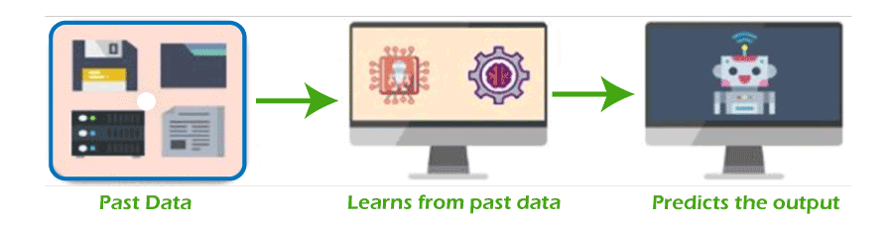
What is Machine Learning?
Machine Learning is defined as the branch of Artificial Intelligence and computer science that focuses on learning and improving the performance of computers/machines through past experience by using algorithms.
AI is used to make intelligent machines/robots, whereas machine learning helps those machines to train for predicting the outcome without human intervention.
How does Machine Learning work?
Machine Learning uses algorithms and techniques that enable the machines to learn from past experience/trends and predict the output based on that data.
However, firstly, machine learning access a huge amount of data using data pre-processing. This data can be either structured, semi-structured, or unstructured. Further, this data is fed through some techniques and algorithms to machines, and then based on previous trends; it predicts the outputs automatically.

Slide 6
Types of Machine Learning
Based on the methods and techniques to teach machines, Machine Learning is categorized into mainly four types, which are as follows:
Supervised Machine Learning
This type of ML method uses labeled datasets to train machines and, based on these datasets, machines predict the output. It needs supervision to train models and predict outputs. Image segmentation, medical diagnosis, fraud detection, spam detection, speech recognition, etc., are some important applications of supervised machine learning. Supervised machine learning can be further categorized into 2 types of problems as follows:
Classification
Regression
Advantages of Supervised machine learning
Supervised machine learning helps to predict output based on prior experience
It helps to provide an exact idea about classes of objects.

Slide 7
Disadvantages of Supervised machine learning
This method is not significant in solving complex problems.
This method does not guarantee to give exact output as it contains both structured and unstructured data.
It needs more computational time to teach ML models.
Unsupervised Machine Learning
Unsupervised machine learning is just the opposite of supervised learning. Unlike supervised machine learning, it does not need supervision, which means it does not require labeled datasets to train machines. Hence, in unsupervised machine learning, the output is predicted without any supervision. The main aim of the unsupervised learning algorithm is to group or categorize the unsorted dataset according to the similarities, patterns, and differences. Network analysis, recommendation system, anomaly detection, singular value decompositions, etc., are some important applications of unsupervised machine learning.
Unsupervised machine learning is further categorized into two types:
Clustering
Association

Slide 8
Advantages of unsupervised machine learning
It can be used to solve complex ML problems as it works with unlabelled data sets.
It is used to solve multiple tasks in comparison to supervised learning.
Disadvantages of unsupervised machine learning
Using unlabelled data sets may predict inaccurate outputs.
It is a relatively complex algorithm as it deals with unlabelled datasets and also does not map with output.
Semi-supervised Machine learning Semi-supervised learning is the combination of both supervised and unsupervised machine learning. Although it uses both labeled and unlabelled datasets to train models and predict the output, mostly, it contains the unlabelled datasets. Advantages of Semi-supervised machine learning
It is simple and easy to understand the algorithm.
It is more efficient.
It is used to solve the drawbacks of Supervised and Unsupervised Learning algorithms.

Slide 9
Disadvantages of Semi-supervised machine learning
It does not include applicable network-level data
It gives less accurate results
Iterations results may not be stable.
Reinforcement Learning
Reinforcement learning is defined as the feedback-based method to learn from past experience and improve the performance of models. In this method, an AI agent automatically explores its surrounding by hitting and trial actions. Further, in reinforcement learning algorithms, machines learn from experience or past data and do not use labeled data. It can be applied in various real-world cases such as video games, resource management, robotics, text mining, operations & research, etc.
Reinforcement learning is further categorized into two types:
Positive reinforcement learning
Negative reinforcement learning

Slide 10
Advantages of reinforcement learning
It is used to resolve complex real-time scenarios where all other techniques are not useful.
It provides the most accurate results because it learns similarly to a human.
It is significant for achieving long-term results.
Disadvantages of Reinforcement Learning
It is not significant for simple scenarios.
It needs a vast amount of data as well as computations
Steps involved in machine learning
There are 7 simple steps involved in machine learning as follows:
Data gathering
Data pre-processing
Choose model
Train model
Test model
Tune model
Prediction

Slide 11
What is Deep Learning?
"Deep learning is defined as the subset of machine learning and artificial intelligence that is based on artificial neural networks". In deep learning, the deep word refers to the number of layers in a neural network.
Deep Learning is a set of algorithms inspired by the structure and function of the human brain. It uses a huge amount of structured as well as unstructured data to teach computers and predicts accurate results. The main difference between machine learning and deep learning technologies is of presentation of data. Machine learning uses structured/unstructured data for learning, while deep learning uses neural networks for learning models.
In machine learning, if a model predicts inaccurate results, then we need to fix it manually. Further, in deep learning techniques, these problems get fixed automatically, and we do not need to do anything explicitly. A self-driving vehicle is one of the best examples to understand deep learning.
Deep learning can be useful to solve many complex problems with more accurate predictions such as image recognition, voice recognition, product recommendations systems, natural language processing (NLP), etc.

Slide 12
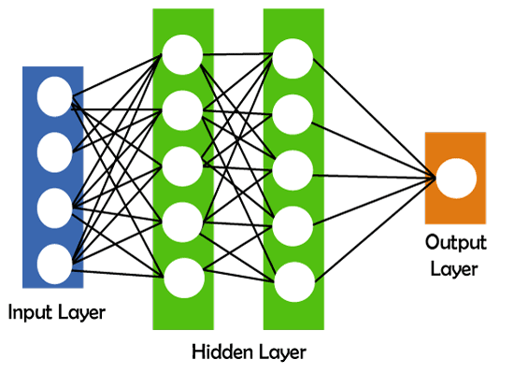
The basic structure of deep learning
Deep learning includes various neural networks that possess different layers, such as input layers, hidden layers, and output layers. The input layer accepts input data; hidden layers are used to find any hidden pattern and feature from the data, and output layers show the expected results.

Slide 13
How does deep learning work?
There are a few simple steps that deep learning follows.
Calculate the weighted sum
Use this weighted sum in step1 as input for the activation function.
The activation function adds bias and decides whether the neuron should be triggered or not.
Predict output at the output layer.
Compare predicted output and actual output and accordingly use the backpropagation method for improving the performance of the model. In this step, the cost function plays a vital role in reducing the error rate.
Types of deep neural networks
There are some different types of deep learning networks available. These are as follows:
Feedforward neural network Radial basis function neural networks
Multi-layer perceptron
Convolution neural network (CNN)
Recurrent neural network
Modular neural network
Sequence to sequence models

Slide 14
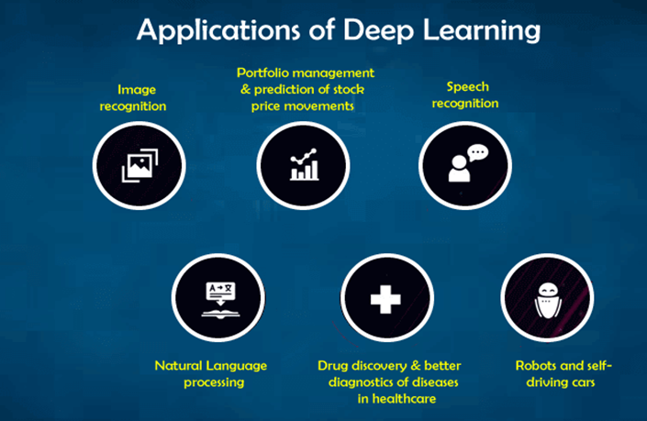
Applications of deep learning
Deep learning can be applied in various industries such as:
Self-driving vehicles
Fraud detection
Natural language processing
Virtual personal assistance
Text, speech, and image recognition
Healthcare, infrastructure, banking & finance, marketing
Entertainment
Education
Automatic game playing
Auto handwriting generation
Automatic language translation
Pixel restoration and photo description & tagging
Demographic and election predictions, etc.

